Slide 1
Safexec
A code signing application
John Hardy
1/23/19

Slide 2
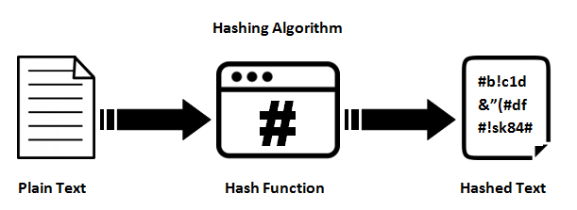
What is code signing?
Code signing is the process of digitally signing executables and scripts to confirm the software author and guarantee that the code has not been altered or corrupted since it was signed.
In other words, it is used to verify that the code has not been tampered with.

Slide 3


Project Description
My project has two parts:
Create an application that will sign an executable file and include that signature inside the file.
Modify the Linux operating system to automatically check that the signatures match before running.
Time permitting, my signing application will have a well-made graphical user interface as well
Target audience:
Anyone who downloads or uses code from a questionable source
i.e. Digital Forensics Investigators, White Hat Hackers, Casual Deepweb Users

Slide 4



Tools
For this project I will be using:
Python
hashlib (a hashing algorithm module)
Secure Hash Algorithm v3
(SHA-3 512 bit version)
Ubuntu
Hex Editor

Slide 5
User’s Point of View
Point of view for code developer:
Build or Compile your code as normal
Run the Safexec application
Provide the file location of the binary executable file
Wait for Safexec to finish hashing the file and modifying the executable
Submit the application to the users
Point of view for user:
Run the modified Safexec Ubuntu operating system
Run the code as normal! If anything goes wrong Linux will tell you.

Slide 6

Why am I interested?
Cryptography is fun!
I wanted to work on a project that would focus on my future career
I want to make my own application from scratch
I want to practice modifying the Linux operating system
Get out of my comfort zone

Slide 7
Questions?
Safexec

